Slide 1
Discrete Structures
Instructor: Zubaria Asma
Course Code: CS-335
Credit Hours: 3(3-0)
Lecture # 16 & 17

Slide 2
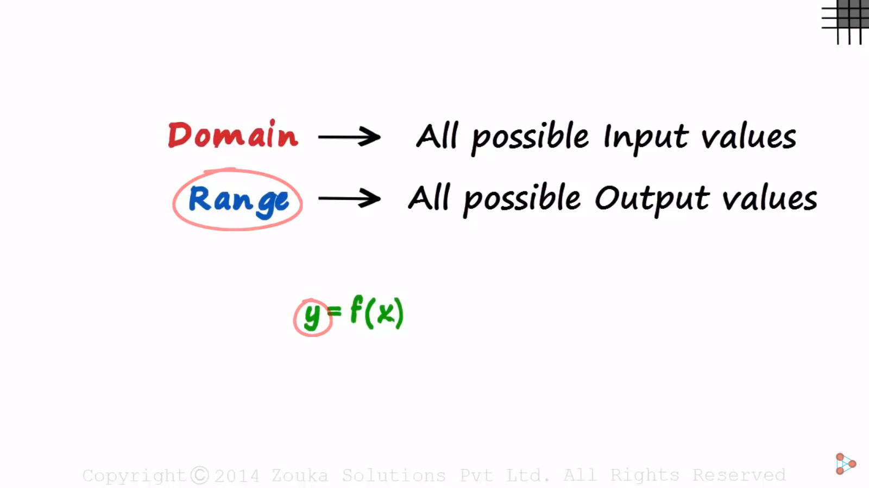
Notes:
Domain contain all possible values that ‘x’ contain

Slide 3
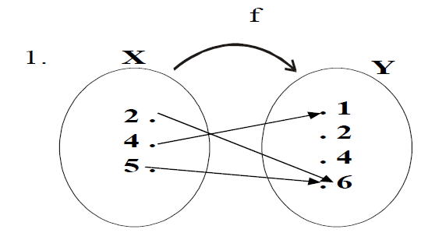
EXERCISE
Determine the range of the functions f, g, h from X = {2,4,5} to Y = {1,2,4,6} defined as:
2. g = {(2,6), (4,2), (5,1)}
3. h(2 ) shows x value = 4 shows y value , h (4) = 4, h(5) = 1
Notes:
Yes these are function,
For range we have to check co-domain value for f we have a range(1,6)

Slide 4
EXERCISE - SOLUTION
1. Range of f = {1, 6}
2. Range of g = {1, 2, 6}
3. Range of h = {1, 4}

Slide 5
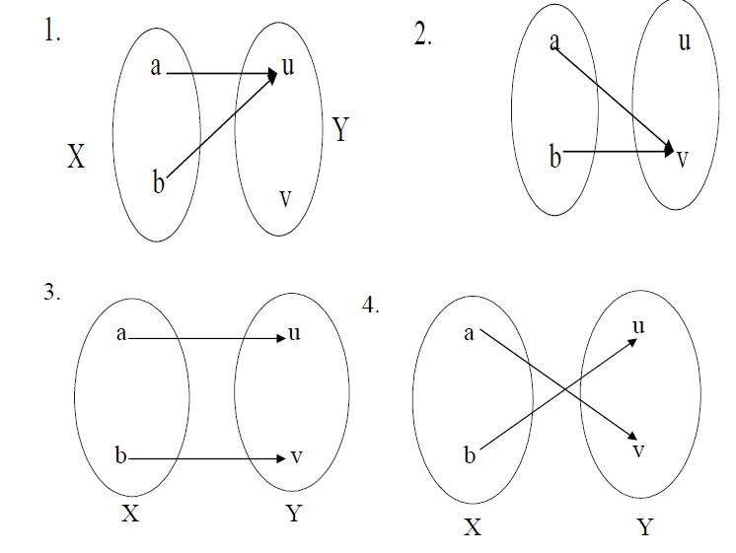
EXERCISE
Find all functions from X = {a,b} to Y = {u,v}

Slide 6
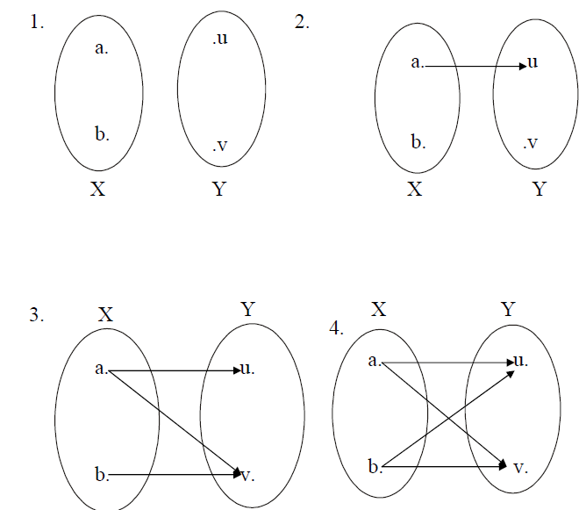
EXERCISE
Find four binary relations from X = {a,b}to Y = {u,v}that are not functions.

Slide 7
TYPES OF FUNCTIONS
INJECTIVE or ONE-TO-ONE FUNCTION
SURJECTIVE FUNCTION or ONTO FUNCTION
BIJECTIVE FUNCTION OR ONE-TO-ONE CORRESPONDENCE
CONSTANT FUNCTION

Slide 8
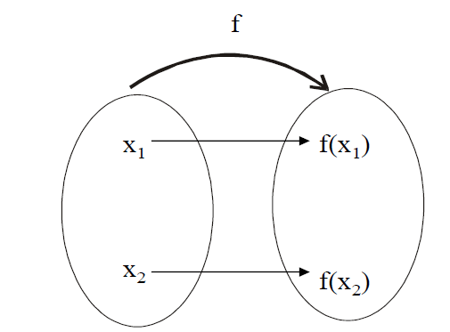
INJECTIVE or ONE-TO-ONE FUNCTION
Let f: X →Y be a function. f is injective or one-to-one if, and only if, ∀ x1, x2 ∈X,
if x1 ≠ x2 then f(x1) ≠ f(x2)That is, f is one-to-one if it maps distinct
points of the domain into the distinct points of the co-domain.
Notes:
Distint point of domain with distinct point of co-domain

Slide 9
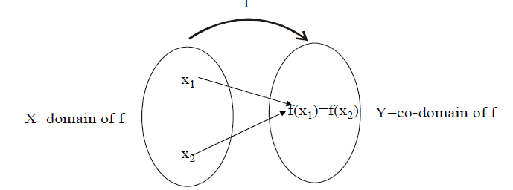
Non INJECTIVE or ONE-TO-ONE FUNCTION

Slide 10
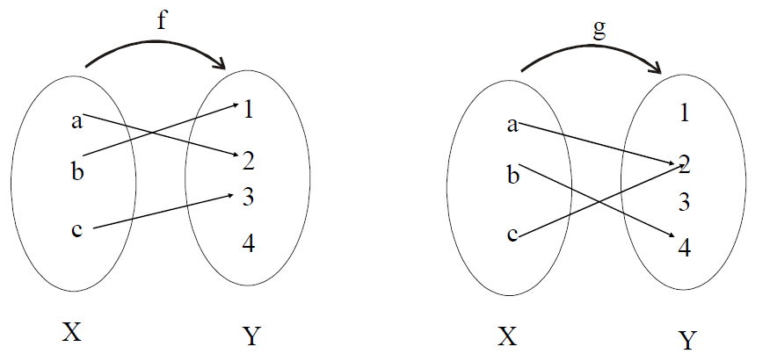
INJECTIVE or ONE-TO-ONE FUNCTION - EXAMPLE
Which of the arrow diagrams define one-to-one functions?
Notes:
F is injective but g is not

Slide 11
INJECTIVE or ONE-TO-ONE FUNCTION - SOLUTION
f is clearly one-to-one function, because no two different elements of X are mapped onto the same element of Y.
g is not one-to-one because the elements a and c are mapped onto the same element 2 of Y.

Slide 12
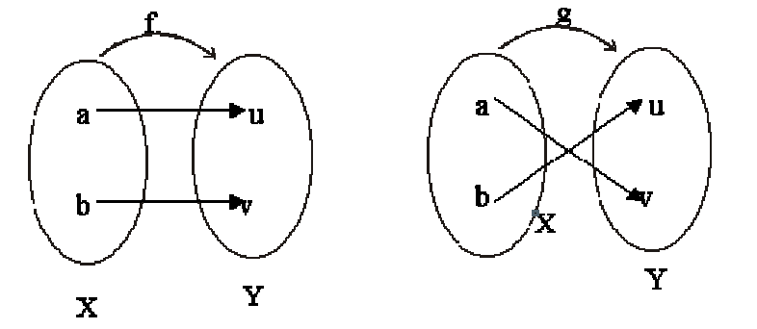
INJECTIVE or ONE-TO-ONE FUNCTION - EXAMPLE
Find all one-to-one functions from X = {a, b} to Y = {u, v}?
Solution:
There are two one-to-one functions from X to Y defined by the arrow diagrams.

Slide 13
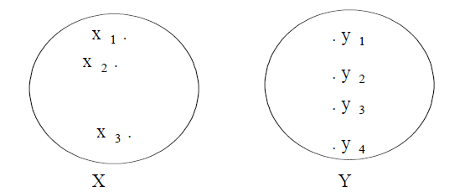
INJECTIVE or ONE-TO-ONE FUNCTION - EXAMPLE
How many one-to-one functions are there from a set with three elements to a set with four elements.
Solution:

Slide 14
INJECTIVE or ONE-TO-ONE FUNCTION - EXAMPLE
x1 may be mapped to any of the 4 elements of Y. Then x2 may be mapped to any of the remaining 3 elements of Y & finally x3 may be mapped to any of the remaining 2 elements of Y.
Hence, total no. of one-to-one functions from X to Y are 4 × 3 × 2 = 24

Slide 15
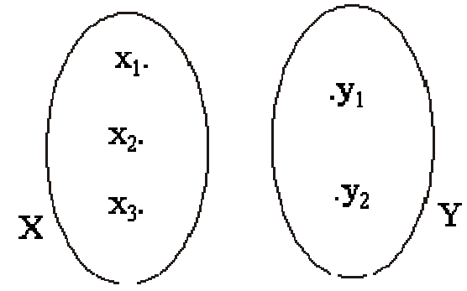
INJECTIVE or ONE-TO-ONE FUNCTION - EXAMPLE
How many one-to-one functions are there from a set with three elements to a set with two elements.
Solution:
Let X = {x 1, x 2, x 3} and Y = {y 1, y 2}

Slide 16
INJECTIVE or ONE-TO-ONE FUNCTION - EXAMPLE
Two elements in X could be mapped to the two elements in Y separately. But there is no new element in Y to which the third element in X could be mapped.
Accordingly there is no one-to-one function from a set with three elements to a set with two elements.

Slide 17
example
Which of the relations define functions from X = {2,4,5} to Y={1,2,4,6}.
R1 = {(2,4), (4,1)}
R2 = {(2,4), (4,1), (4,2), (5,6)}
R3 = {(2,4), (4,1), (5,6)}
R1 is not a function, because 5 ∈X does not appear as the first element in any ordered pair in R1.
R2 is not a function, because the ordered pairs (4,1) and (4,2) have the same first element but different second elements.
R3 defines a function because it satisfy both the conditions of the function that is every element of X is the first element of some order pair and there is no pair which has the same first order pair but different second order pair.
Notes:
Which is the one to one function?

Slide 18
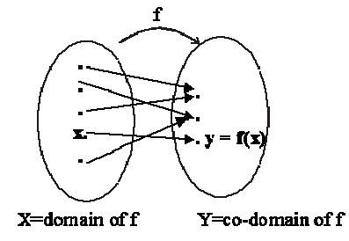
SURJECTIVE FUNCTION or ONTO FUNCTION:
Let f: X→Y be a function. f is surjective or onto if, and only if, "∀ y∈Y, ∃ x∈X such that
f(x) = y.
That is, f is onto if every element of its co-domain is the image of some element(s) of its domain i.e., co-domain of f = range of f
Notes:
Co-domain each element must be fully covered by domain

Slide 19
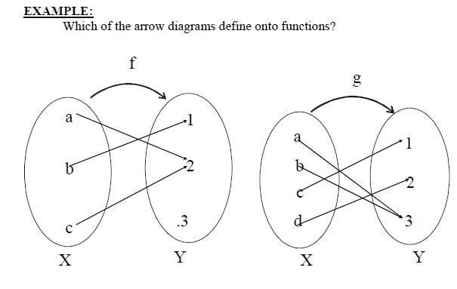
SURJECTIVE FUNCTION or ONTO FUNCTION:
Notes:
G is the on To function

Slide 20
SURJECTIVE FUNCTION or ONTO FUNCTION:
SOLUTION:
f is not onto because 3 ≠ f(x) for any x in X. g is clearly onto because each
element of Y equals g(x) for some x in X.
as 1 = g(c);,2 = g(d);3 = g(a) = g(b)

Slide 21
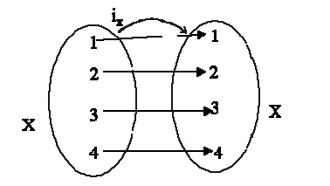
BIJECTIVE FUNCTION or ONE-TO-ONE CORRESPONDENCE
A function f: X→Y that is both one-to-one (injective) and onto (surjective) is called a bijective function or a one-to-one correspondence.
Notes:
Both one to one and On To fuction

Slide 22
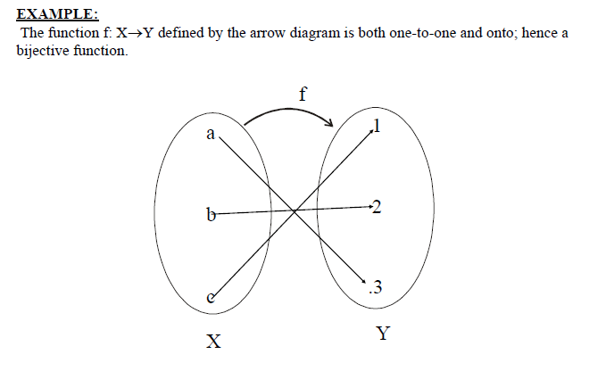
BIJECTIVE FUNCTION or ONE-TO-ONE CORRESPONDENCE

Slide 23
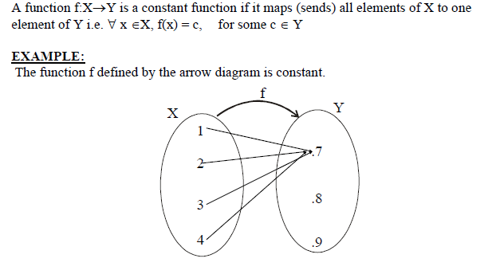
CONSTANT FUNCTION:

Slide 24

THANK YOU

